Slide 1
Threat Modeling: Engineering and Science
Adam Shostack
CERIAS
February, 2025

Slide 2
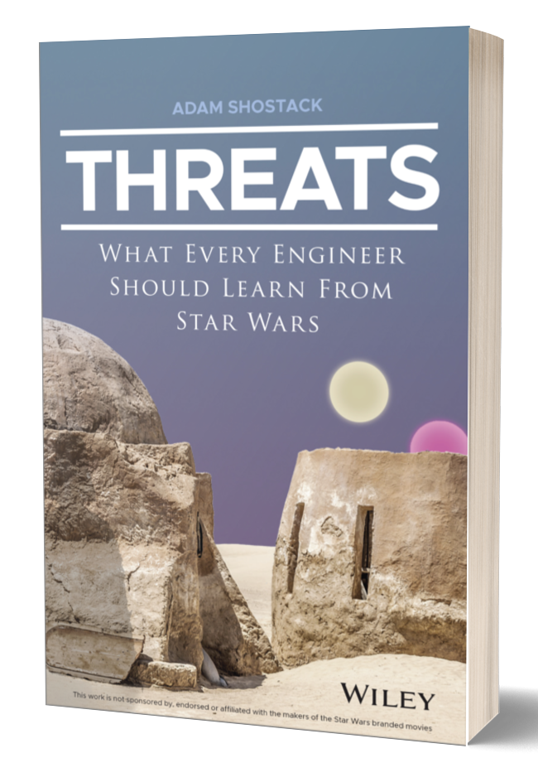
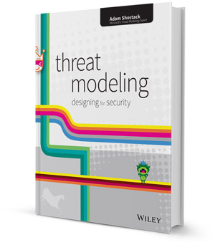
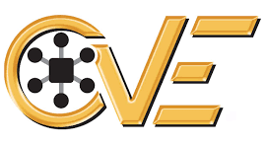
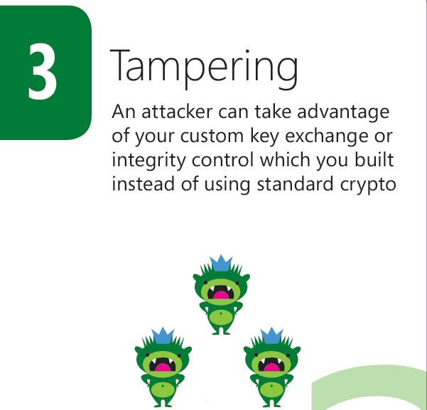
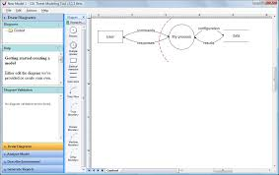
About Adam Shostack

Slide 3
Today
Building secure systems
Overview and context
Threat modeling tools and techniques
Risk
Risk as a tool and frame
How do we measure risk?
Where does that lead us?
This entire talk focuses on cybersecurity risk, abbreviated “risk”

Slide 4
Building secure systems

Slide 5
What does that mean?
“Secure” isn’t like “lift 1000 kg to LEO” or even“1000 bits per second”
Doesn’t get hacked!
Is that preparation by defenders, or just luck?

Slide 6
Common frames/definitions of security
“A condition that results from the establishment and maintenance of protective measures that enable an organization to perform its mission or critical functions despite risks posed by threats to its use of systems.”
“Protection against intentional subversion or forced failure.”
Resilient in the face of attack
Doesn’t surprise its creator

Slide 7
Common frames/definitions of security
“A condition that results from the establishment and maintenance of protective measures that enable an organization to perform its mission or critical functions despite risks posed by threats to its use of systems.”
“Protection against intentional subversion or forced failure.”
“A system which has not been specified cannot be buggy, merely surprising” (and other formalist ideas)
Resilient in the face of attack
Doesn’t surprise its creator

Slide 8
Analysis of NIST 800-53 definition
“A condition that results from the establishment and maintenance of protective measures that enable an organization to perform its mission or critical functions despite risks posed by threats to its use of systems.” (NIST 800-53 and others)
“What do I need to do?
What are those risks? Which ones matter?
Which threats matter? (Threats, in the sense of threat actors)
Where’s the list so I can be complete?
What’s involved in a “mission” for a business?
What about cascade issues (“Can’t get incident response work done because Slack is down because a botnet crashed Dyn, a DNS provider”?)

Slide 9
Definition issues aren’t an excuse
We know insecurity when we see it
Akin’s laws of engineering apply to security
Many laws apply surprisingly well
“Design is based on requirements. There's no justification for designing something one bit ‘better’ than the requirements dictate.”
Security requirements are not crisp
Specific, measurable
What’s “enough”?

Slide 10
Why is “building secure systems” hard?
We lack a crisp definition of “secure”
We have a lot of standards and rules to comply with
Compliance helps avoid insecurity
At a cost…
The standards lack a “germ theory”
Are most breaches caused by phishing or a lack of patching?

Slide 11
My building secure systems context
25+ years in application security
Industry consultant and trainer
“Nothing” is “good enough” is often true
Focus on lightweight methods

Slide 12
Threat modeling

Slide 13
What is threat modeling?
Using models to help us think about security
Threats meaning possible future problems
TM applies to both systems you produce and systems you deploy
The “measure twice, cut once” of security
“You can fix it on the drawing board with an eraser, or on the job site with a sledgehammer”

Slide 14
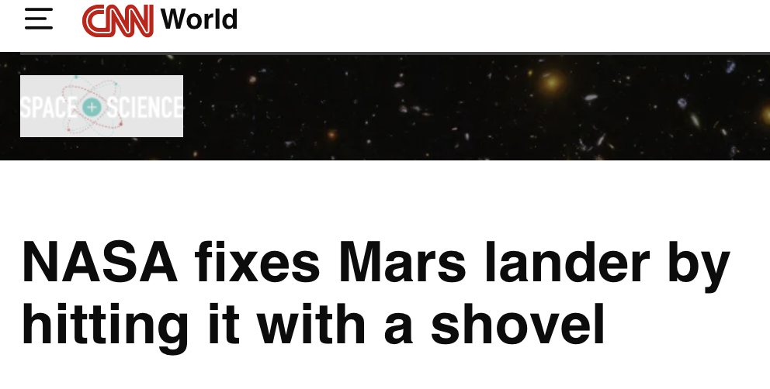
Sometimes you have to fix it onsite

Slide 15
How do we threat model?
Four Question Framework
What are we working on?
What can go wrong?
What are we going to do about it?
Did we do a good job?
Threatmodelingmanifesto.org

Slide 16
How do we threat model?
Four exceptionally simple questions
Enable
Scenario specific ways of answering the questions (next slide)
Appropriate alignment to engineering processes
Common language
Identify, enhance boundaries
More boundaries (isolation)
Better enforcement/attenuation by boundary code

Slide 17
Example ways to answer each question
What are we working on?
Whiteboard diagrams
Lego models
Data flow diagrams
What can go wrong?
Brainstorming
STRIDE (mnemonic for Spoofing, Tampering, Repudiation, Info disclose, Denial of service, Expansion of authority
Kill chains such as MITRE ATT&CK

Slide 18
Example ways to answer each question (2)
What are we going to do about it?
Address problems
Code defensively
Add barriers (Run in several accounts)
Add technical controls like ID/Access Management or firewalls
When those mitigation approaches don’t work easily
Make tradeoffs (usability, compatibility)
Use risk management strategies (Eliminate, Accept, Transfer)
We often want to use likelihood to help prioritize
Sounds like risk, again!

Slide 19
Risk in context
(Bhudia, et al, A Review of the General Risk Cyber Quantification Landscape, RISCS TR-D1, 2024, https://riscs.org.uk/cyber-risk-quantification-reports/)
There are over 200 risk management standards (!)
NASA has an very mature approach
Continuous Risk Management, Risk Informed Decision Making
Also NASA Risk Management Handbook:
“While there will probably always be vigorous debate over the details of what comprises the best approach to managing risk, few will disagree that effective risk management is critical to program and project success and affordability.”

Slide 20
A few questions (focused on cyber)
“While there will probably always be vigorous debate over … the best approach to managing risk, few will disagree that effective risk management is critical to program and project success and affordability.”
If we can’t agree on how, to what are we agreeing?
Is risk management being treated as axiomatic? Why?
Are we improving project/program/mission success rates?
Are we achieving affordability?

Slide 21
“Risk” as a commonplace
“Security and compliance are not the same thing.
Security focuses on defending and protecting the data assets while compliance is the specific set of controls implemented to improve security.
Systems that support operations carried out by humans and interact with other systems and organizations can never be 100% secure.
As a result, a risk management approach must be taken to balance the mission of the organization and the cyberinfrastructure supporting that mission with security controls and budget constraints.
Compliance frameworks specify an agreed-upon set of activities and practices that provide due diligence to manage risk to an acceptable level.”
Jan, 2025 CACM Opinion offered a convenient example

Slide 22
Analysis
“As a result, a risk management approach [RMA] must be taken to balance the mission of the organization and the cyberinfrastructure supporting that mission with security controls and budget constraints.”
Is that a result of the preceding statement? (“can never be 100% secure.”)
Is that the only result (“must”)?
Spoiler: No.*
Does a RMA help find controls that work within budget constraints?
Is it cost effective?
Does it support budget constraints
* Steven B. Lipner and Butler W. Lampson, Risk Management and the Cybersecurity of the U.S. Government, September, 2016 https://www.nist.gov/system/files/documents/2016/09/16/s.lipner-b.lampson_rfi_response.pdf

Slide 23
What is risk, anyway?
(This section reflects collaboration with Shannon Lantzy and papers under submission)

Slide 24
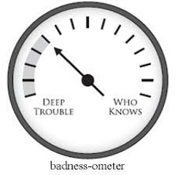
Initial thoughts
Risk is not a physical property
There is no “risk-o-meter”
Risk doesn’t derive from physical units
(In the sense of f=ma)
Physical objects like bridges have risk of collapse
Constructs like investment portfolios have risk
Risk is a concept that we use
But remember, 200 different standards!

Slide 25
Risk, the word
From the old Italian “riscare”, to dare, venture or gamble
“chi non risica non rosica” (nothing ventured, nothing gained)
Often means a danger, eg, “…despite risks posed by threats to its use of systems…”
Often implies quantification
“A risk is a threat with quantified likelihood and impact” (me)

Slide 26
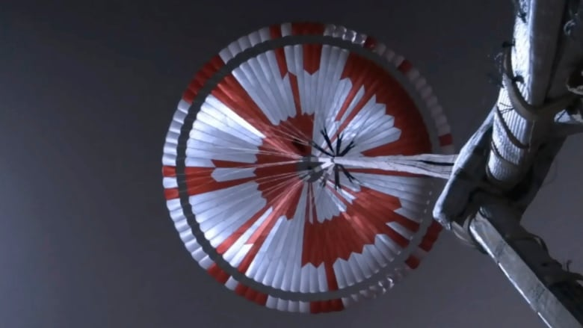

Slide 27
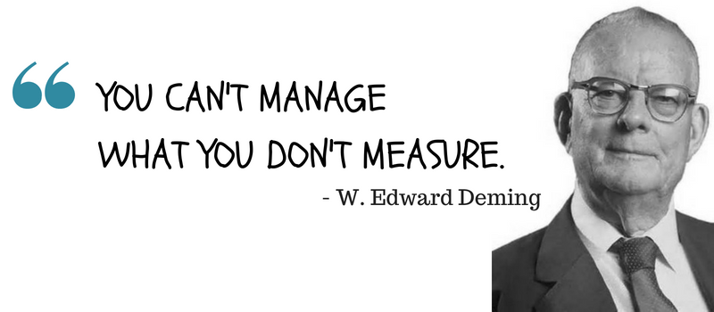
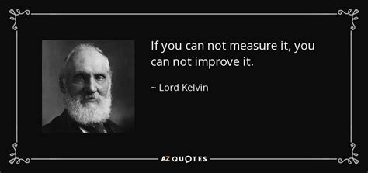
Does managing risk depend on measuring risk?

Slide 28
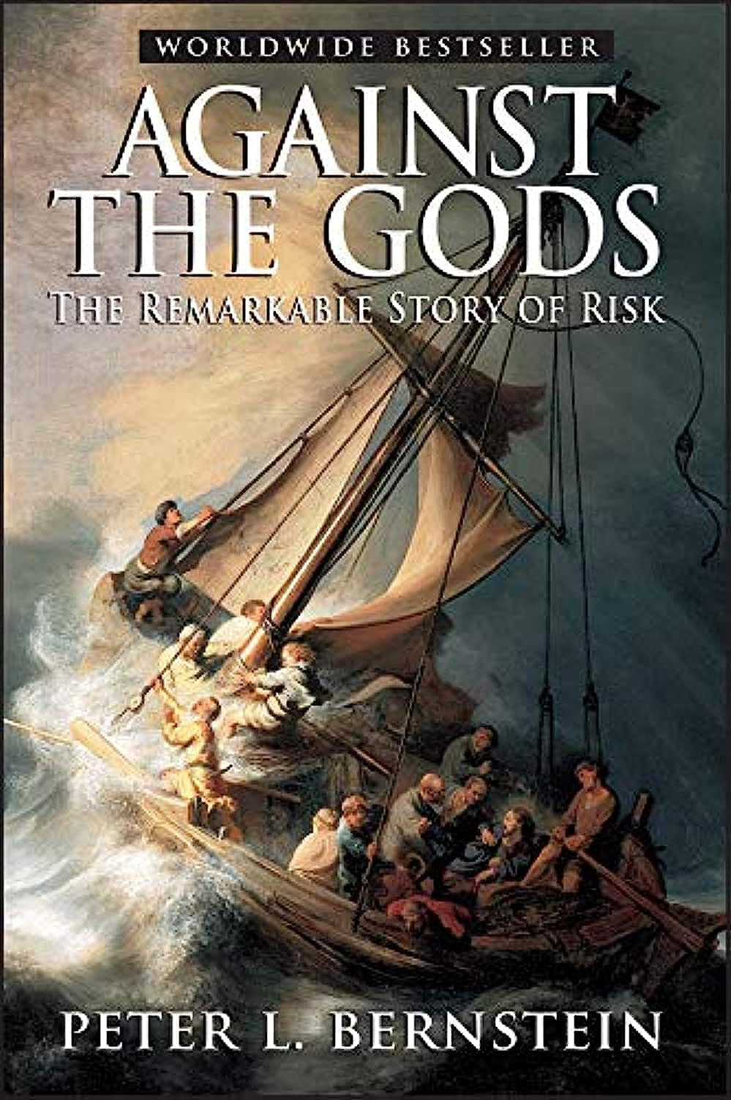
Risk measurement history
Insurance for ships
Gambling!
Pascal + Fermat and the interrupted game
Annuities/pension plans
Stock portfolios

Slide 29
Risk management history @ NASA (1)
Design vs statistics debate
Bell, Trudy E., and Karl Esch. “The Challenger Disaster: A Case of Subjective Engineering”, IEEE Spec (Online) 1986 https://spectrum.ieee.org/the-space-shuttle-a-case-of-subjective-engineering
Feynman, Richard, “Personal Observations on Reliability of Shuttle”, Report of the PRESIDENTIAL COMMISSION on the Space Shuttle Challenger Accident, Volume 2, 1986, https://www.nasa.gov/history/rogersrep/v2appf.htm
FMEA, STAMP, etc
Tech Readiness (next slide)
(Grant Tremblay)
https://www.granttremblay.com/blog/trls

Slide 30
Risk management history @NASA (2)
Tech Readiness Levels
NASA, 1970s
(Grant Tremblay)
https://www.granttremblay.com/blog/trls

Slide 31
Risk measurement general history (again)
Risk measurement easiest with iterations
TRL are empirical

Slide 32
Risk measurement (1): Sky Crane
What was the risk of mission failure due to the Sky Crane?
Please don’t shout out the approved answer ☺
Mission: Land the rover safely
Possible answers, August 1, 2012
Between 0 .. 1 (inclusive)
Possible answers, Aug 31, 2012
Between 0 .. .99

Slide 33
Risk measurement (2): Europa Clipper
What was the additional risk from the mosfet issues?
How does the canary box impact risk?
“The manufacturer is working with the mission team to support ongoing radiation test and analysis efforts in order to better understand the risk of using these parts on the Europa Clipper spacecraft.” (NASA official blog, July 11, emphasis added)
Is mission risk changed by the canary box?
Heating and annealing to extend life seems like risk mitigation
Seem very hard to quantify without the canary box, maybe even with it

Slide 34
Risk measurement challenges
Risk is not a physical property
Risk doesn’t derive from physical units
(In the sense of f=ma)
Physical objects like bridges have risk of collapse
Iteration is common to measuring risk
1 Skycrane landing is … ?

Slide 35
Properties of risk management techniques

Slide 36
Properties: Accuracy + precision
Accuracy: how close measures are to truth
Precision: how close they are to each other
Image originally from https://wp.stolaf.edu/it/gis-precision-accuracy/

Slide 37
Property: Uncertainty
(Kay & King Radical Uncertainty: Decision-making for an Unknowable Future (The Bridge Street Press, 2020), quoted in Simpson, Into the unknown: the need to reframe risk analysis, J Cybersecurity, 14 November, 2024)
Inputs that are not known
Resolvable: Amicable to being looked up
Radical uncertainty has many dimensions: obscurity; ignorance; vagueness; ambiguity; ill-defined problems; and a lack of information that in some cases but not all we might hope to rectify at a future date (emphasis added)
Adaptive behavior by attackers seems different than “uncertain”

Slide 38
Property: Sensitivity
How changes in the inputs influence the results
Understand the reliability or robustness of the conclusions
Identify how best to control a system or manage its outputs
Focus future empirical studies… to improve estimates of inputs that would lead to the most improvement in the estimates of the outputs.
(Ferson and Tucker, Sensitivity in Risk Analyses with Uncertain Numbers, Sandia Tech Report 2006-2801, , 2006, https://www.osti.gov/servlets/purl/886899)

Slide 39
Measurement strategies
Precision
Have many people quantify some risk
Measure reliability (inter-, intra-rate), meaure spread
Differences may not be independent and so not show a normal distribution
Can be measured without knowing “the” real value
Accuracy
Requires(?) iterations
Every failure gives you data
Failures may be really costly
Near misses give us data

Slide 40
Cost as a property of risk management
Doing work has a cost
Includes
Effort to produce the measurement
Justification + record keeping
Vigorous debate
(The debate may add value)
Cost relates to “return on investment”
“Return” may be hard to measure

Slide 41
Managing cost
If work is expensive or unreliable, do it once
Acceptable answer tables
Do the work once, and write down the answers
For example, what’s an acceptable rate of phishing test failures?
This is a question for NIST or Sector Risk Management Agencies
Consulting experience: every company is trying to answer it for themselves
The table will be wrong
Methodological transparency lets us ask: Do we have better data than those who created it?
If not, use the table of wrong, but accepted, answers

Slide 42
Where does that lead us?
Better mission support?

Slide 43
One possible approach to evaluating risk management approaches
Measure precision + cost?
Seems unsatisfying?
Are we comparing real systems to aspirational ones?

Slide 44
Another approach
Stop treating “risk management” as axiomatic, at least in cyber
Start treating it as hypotheses
The Green approach will result in
precision > 85%
cost of $5000 per estimation
a three year retrospective predictive accuracy of at least 25%.
The Red approach will result in
precision > 60%
cost of $1000 per estimation
three year retrospective predictive accuracy of 15%
(I don’t think we have clear ways to measure accuracy yet)

Slide 45
A possible strategy
Can we treat “(cyber) risk management” as a tech, subject to TRL?
Variant A: Each specific approach (red, green) has a readiness level
Variant B: The idea of risk management can be subjected to TRL
Tested under these conditions, not under those

Slide 46
In conclusion
Asking “why do we believe that” is a good research strategy
Is risk management as helpful as we hope?
Threat modeling techniques like the Four Question Frame are designed to help either way

Slide 47
Thank you!

Slide 48
Questions?
Now or
adam@shostack.org

Slide 49
A few references
Shostack.org/blog (lots on threat modeling)
https://shostack.org/resources/lessons (including near misses)
https://shostack.org/resources/cyber-public-health
(There’s a lot there that may not apply super-well to the flying side of missions, but might be helpful for the ground side, so I left it out of this talk)

Slide 50
Akin’s laws that apply well to security
To design a system right takes an infinite amount of effort. This is why it's a good idea to design them to operate when some things are wrong.
Design is an iterative process. The necessary number of iterations is at least one more than the number you have currently done. This is true at any point in time.
The fact that an analysis appears in print has no relationship to the likelihood of its being correct.
Cyberspace is a completely unforgiving environment.
There is never a single right solution. There are always multiple wrong ones, though.

